Slide 1

Young Professional – Spain Section
Manuel Ballesteros
Chair YP IEEE Spain/ R&D Engineer at RF Explorer
m.ballesteros.carballo@ieee.org

Slide 2

NEW LOGO

Slide 3
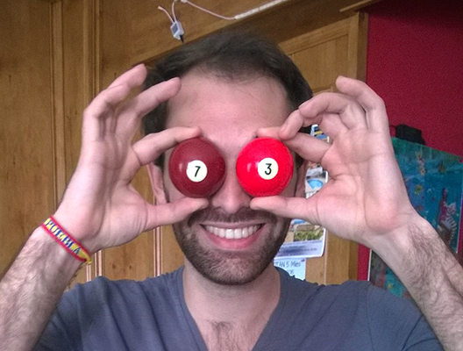
Juan Emilio Zurita (Sevilla)

Slide 4
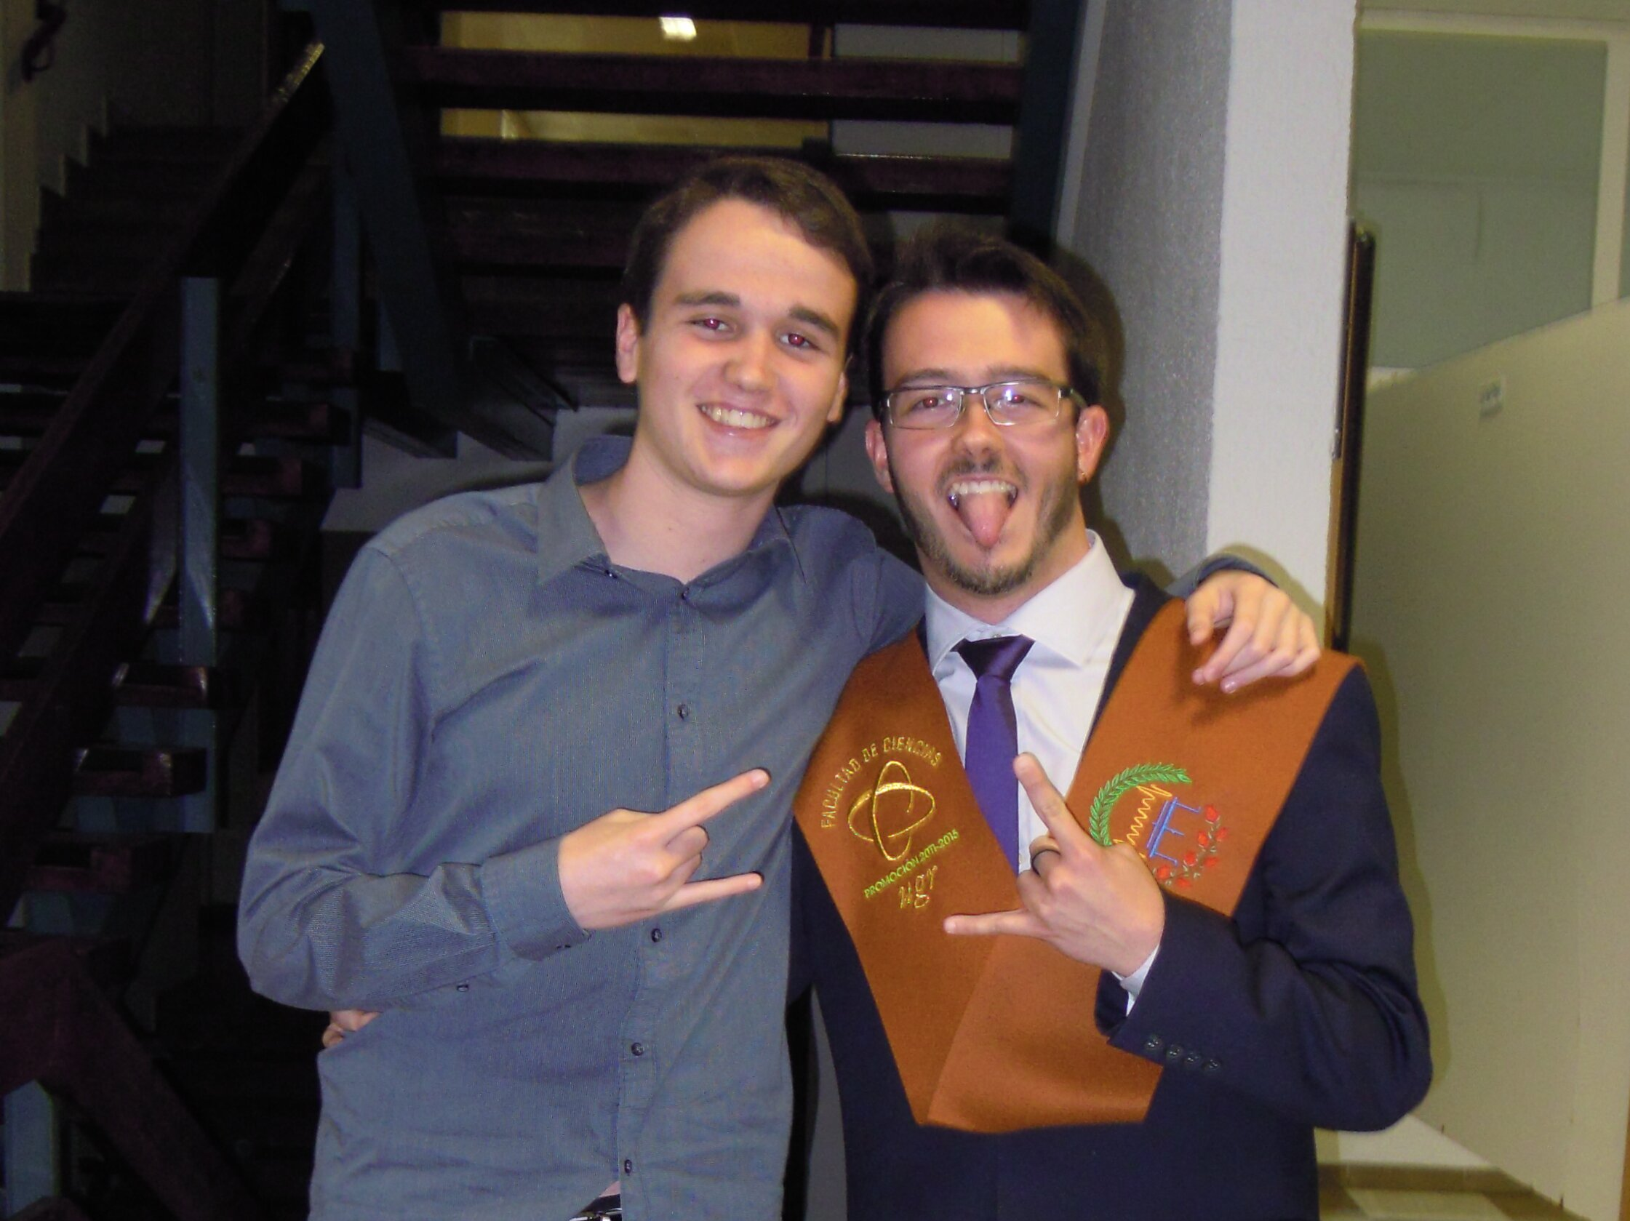
Jesús Rodríguez
(Granada)

Slide 5
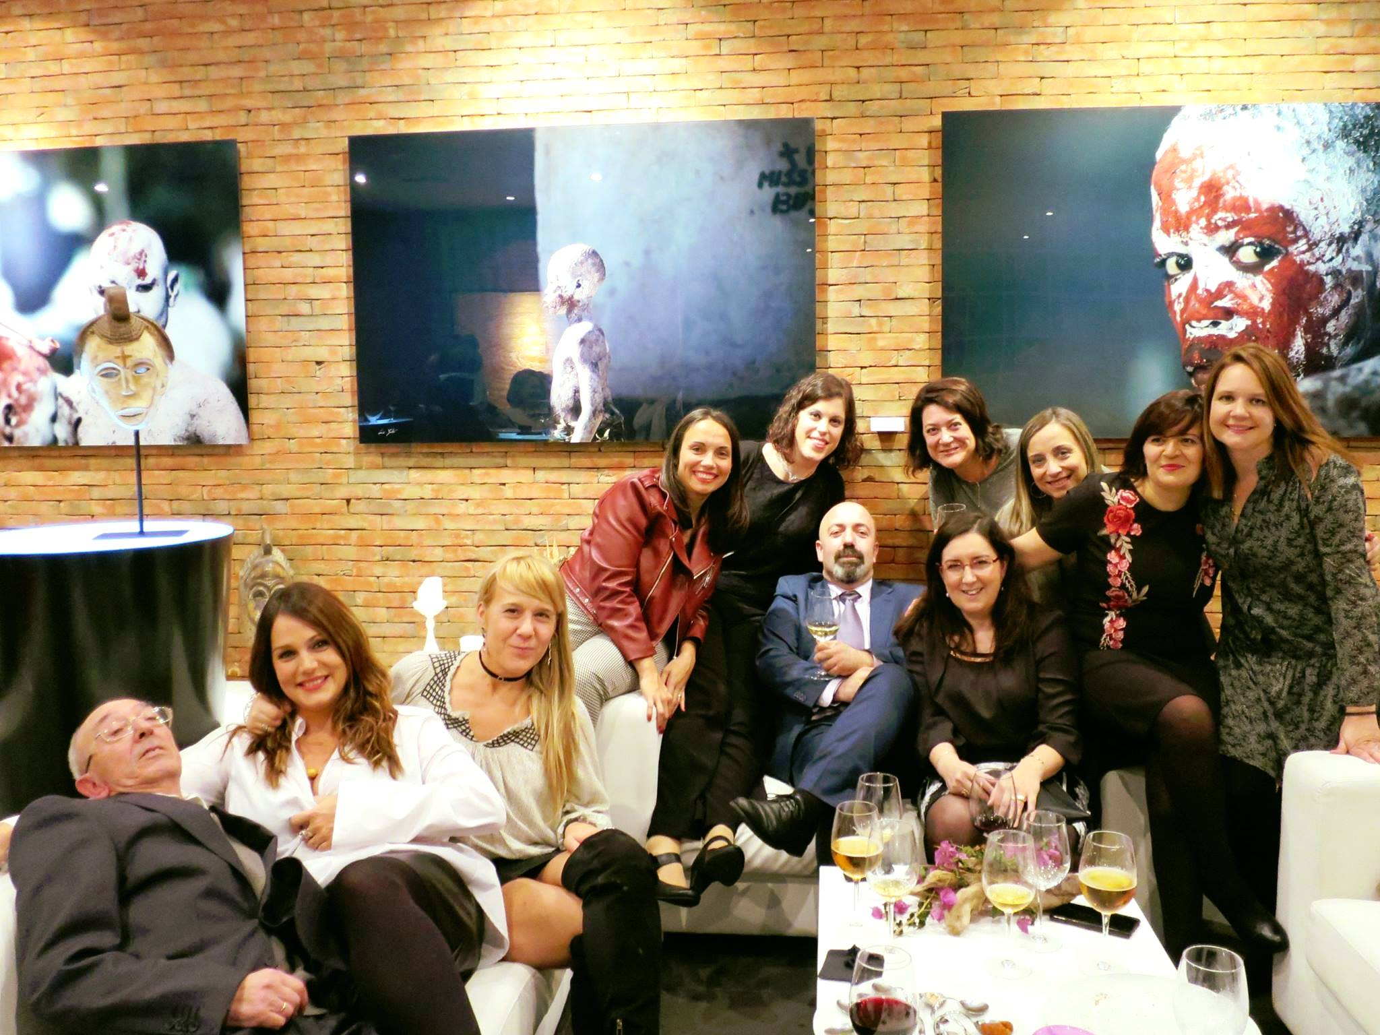
Ramón Carrasco (La Coruña)

Slide 6
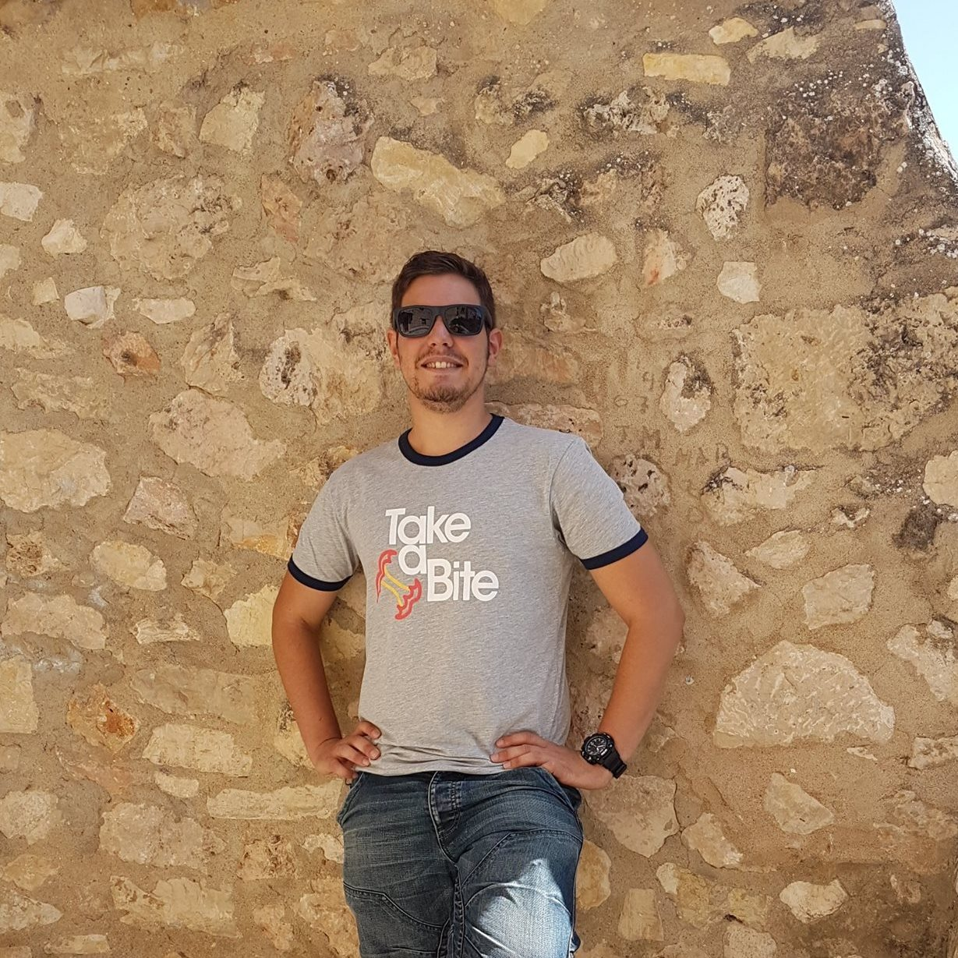
Emilio Gómez
(Elche)

Slide 7
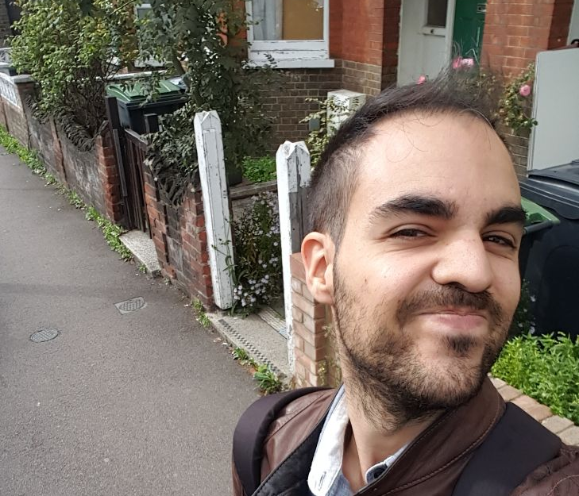
Rubén Martínez
(Cartagena)

Slide 8
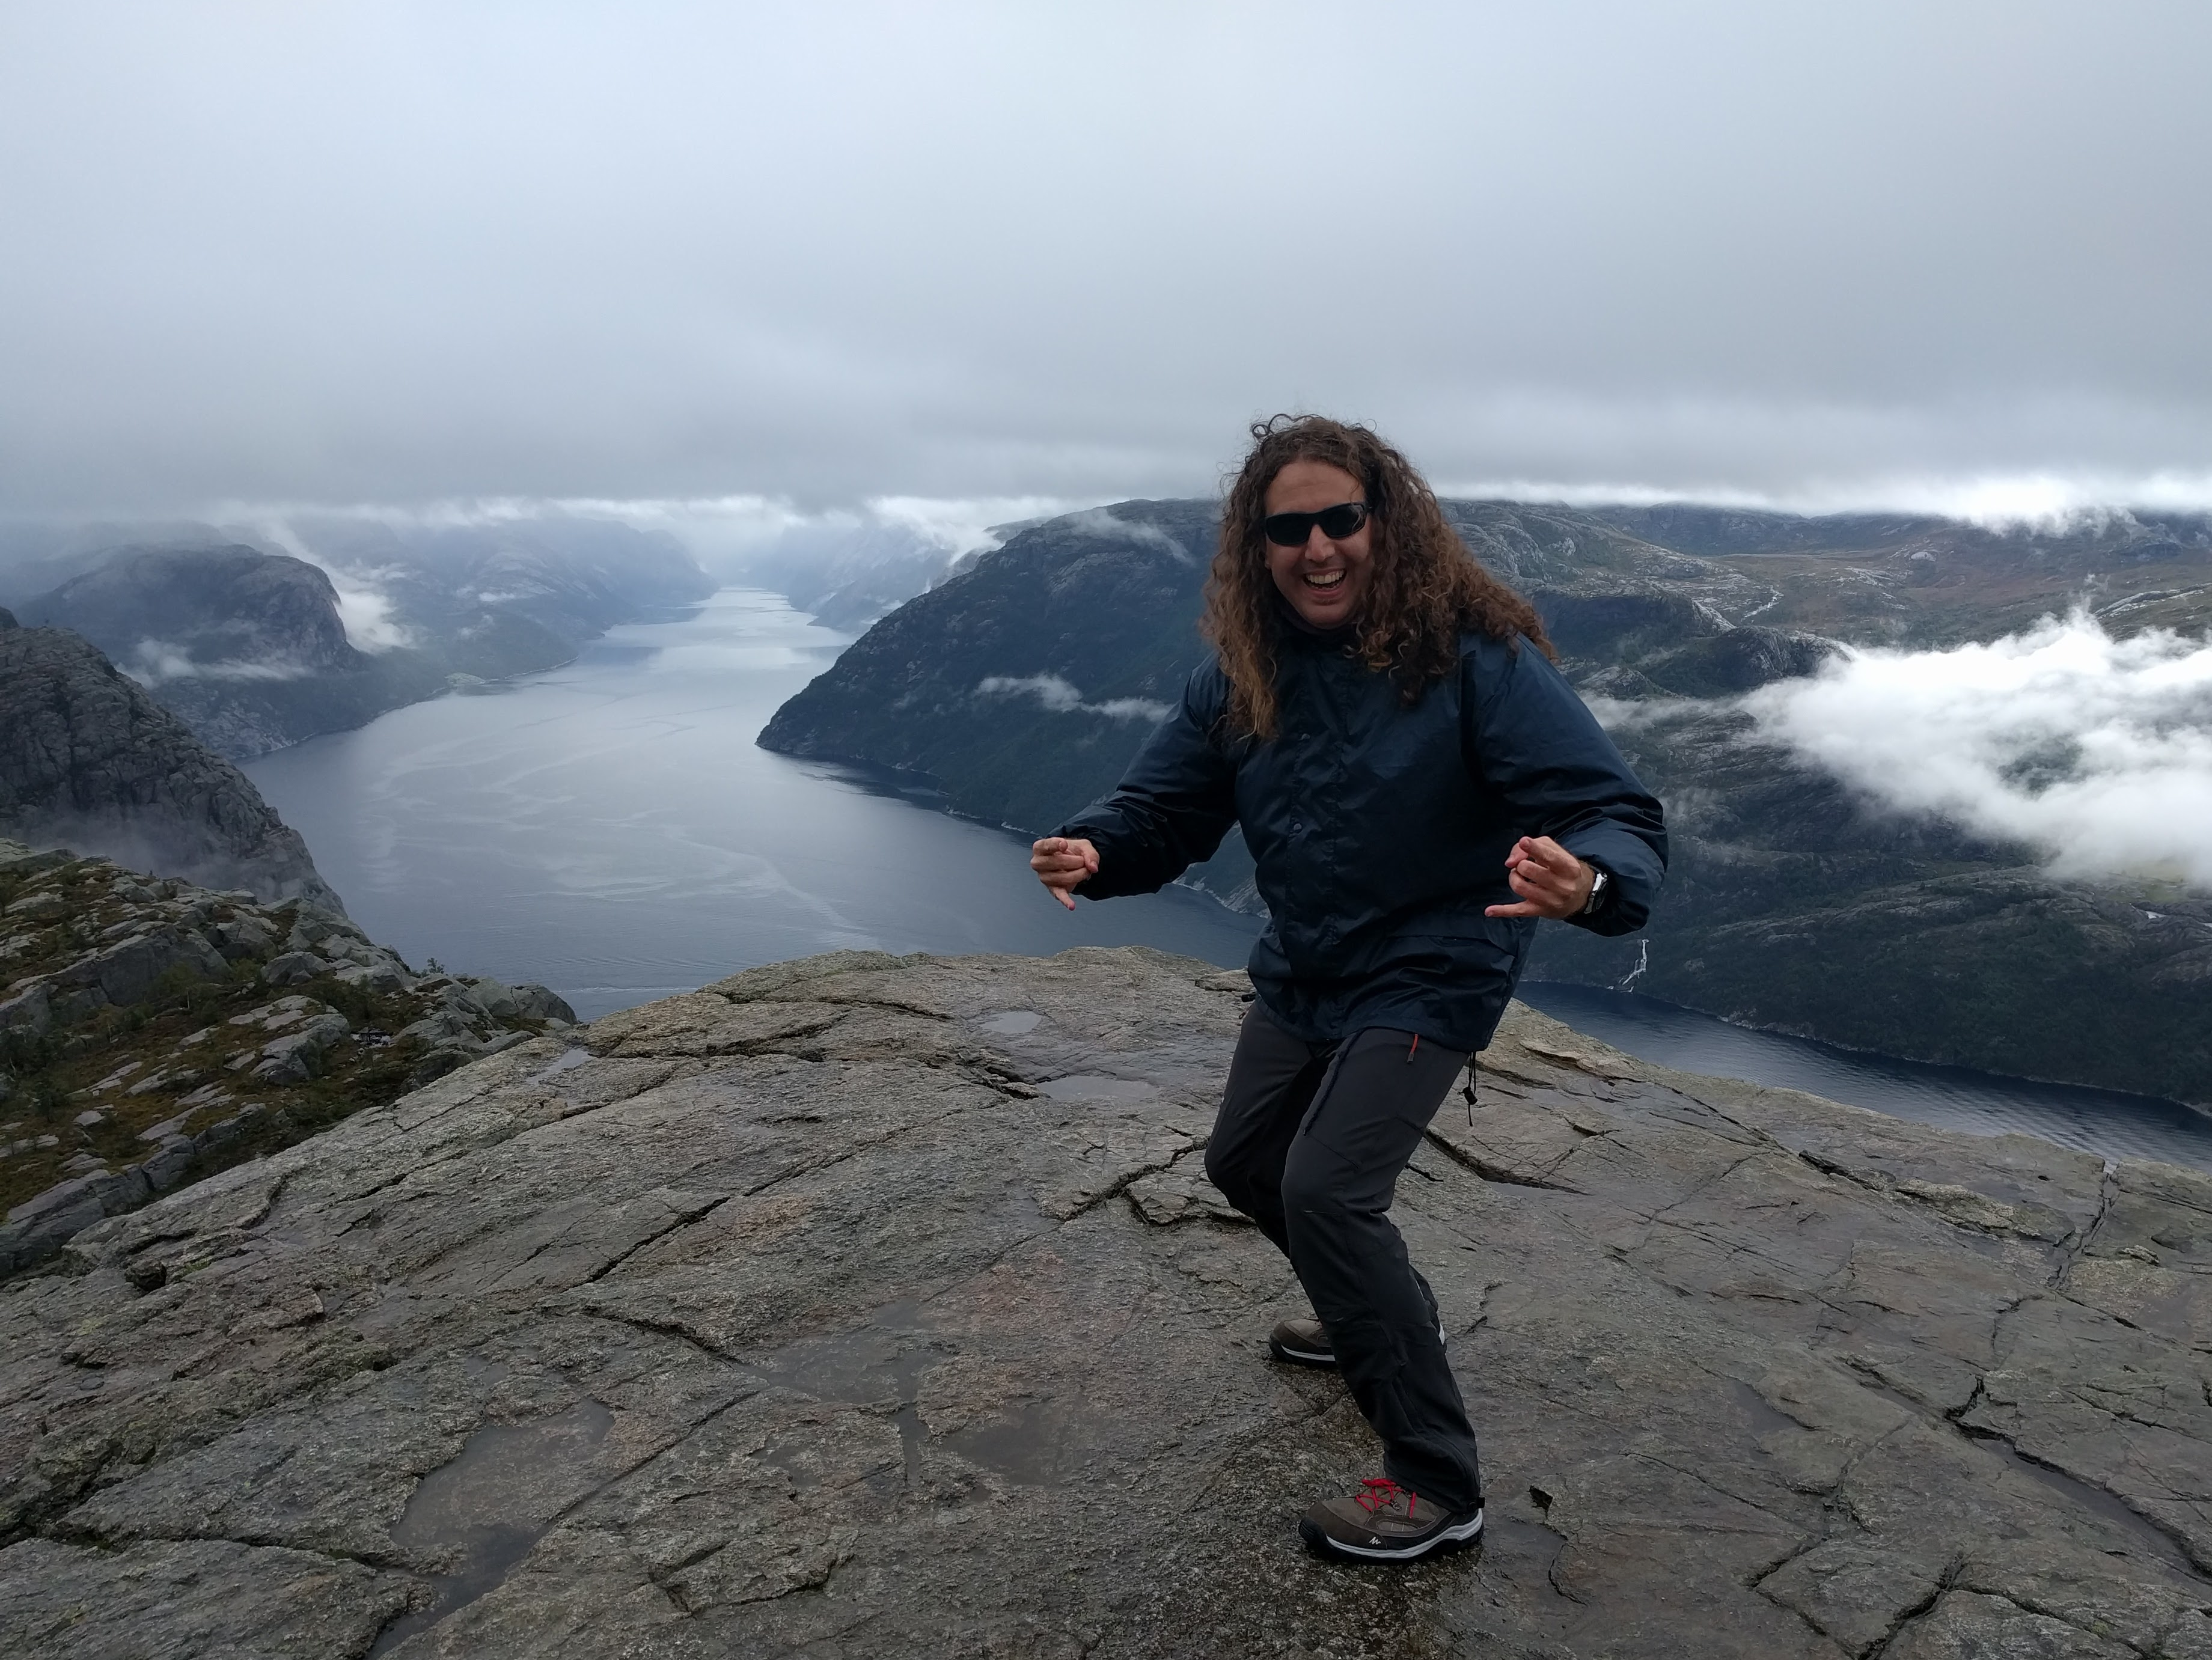
Manuel Ballesteros
(Madrid)

Slide 9

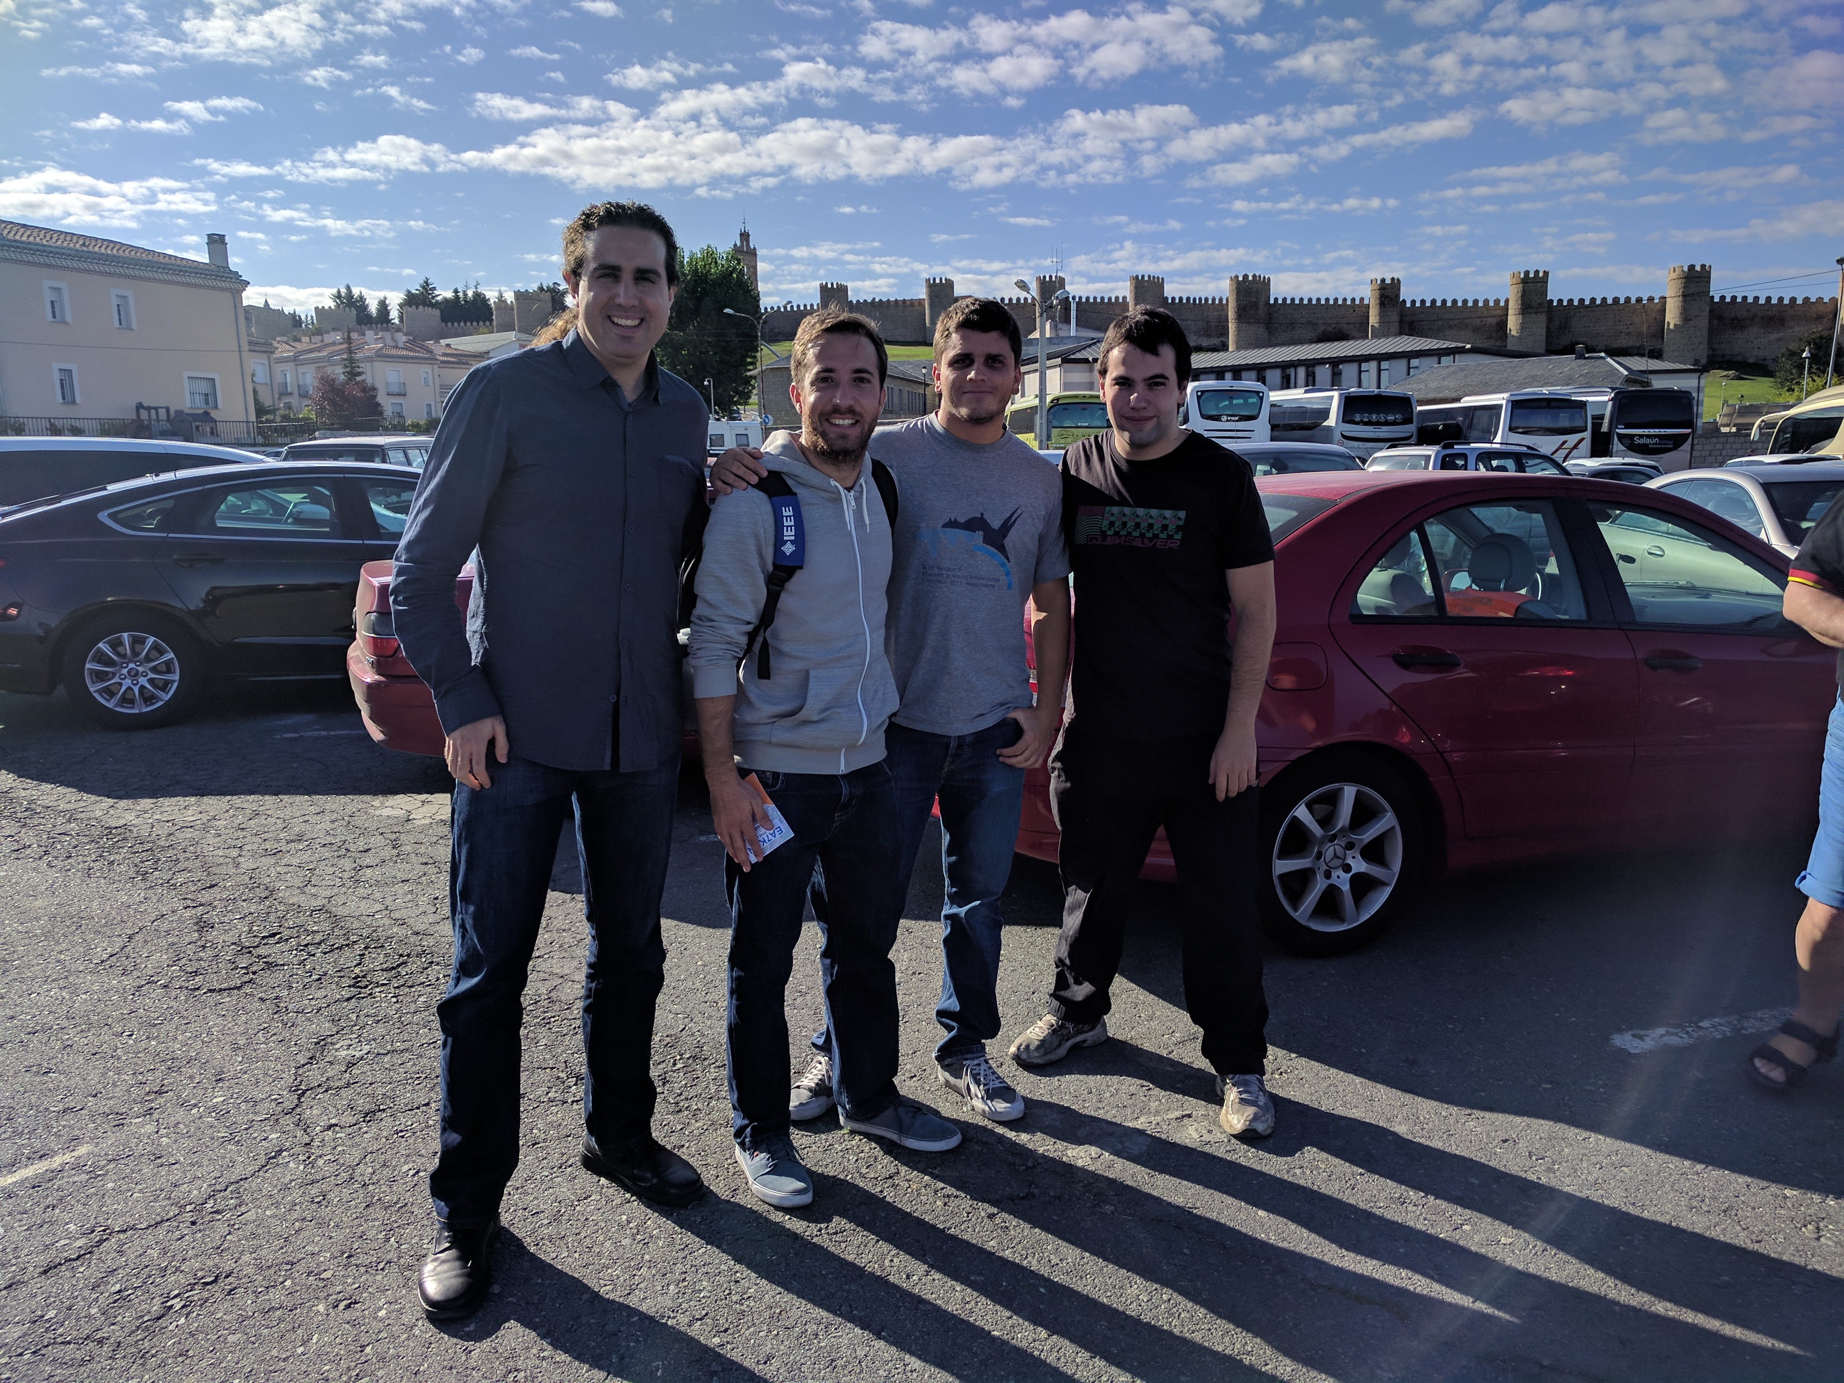
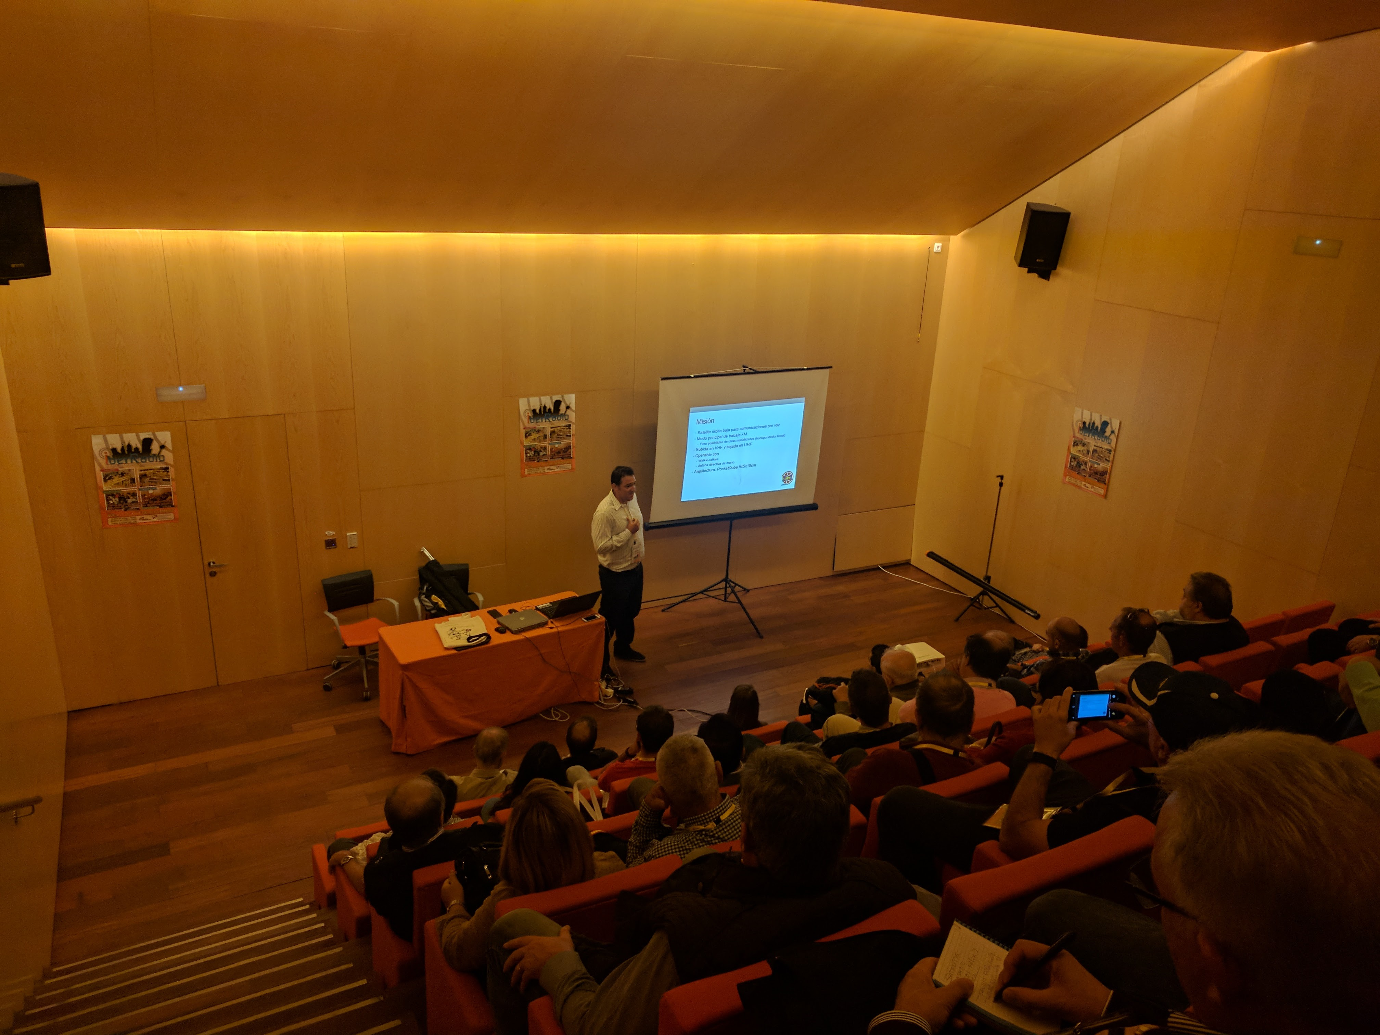
NEW ACTIVITY

Slide 10

NEW ACTIVITY
Innovative Project
Round Table + Networking

Slide 11
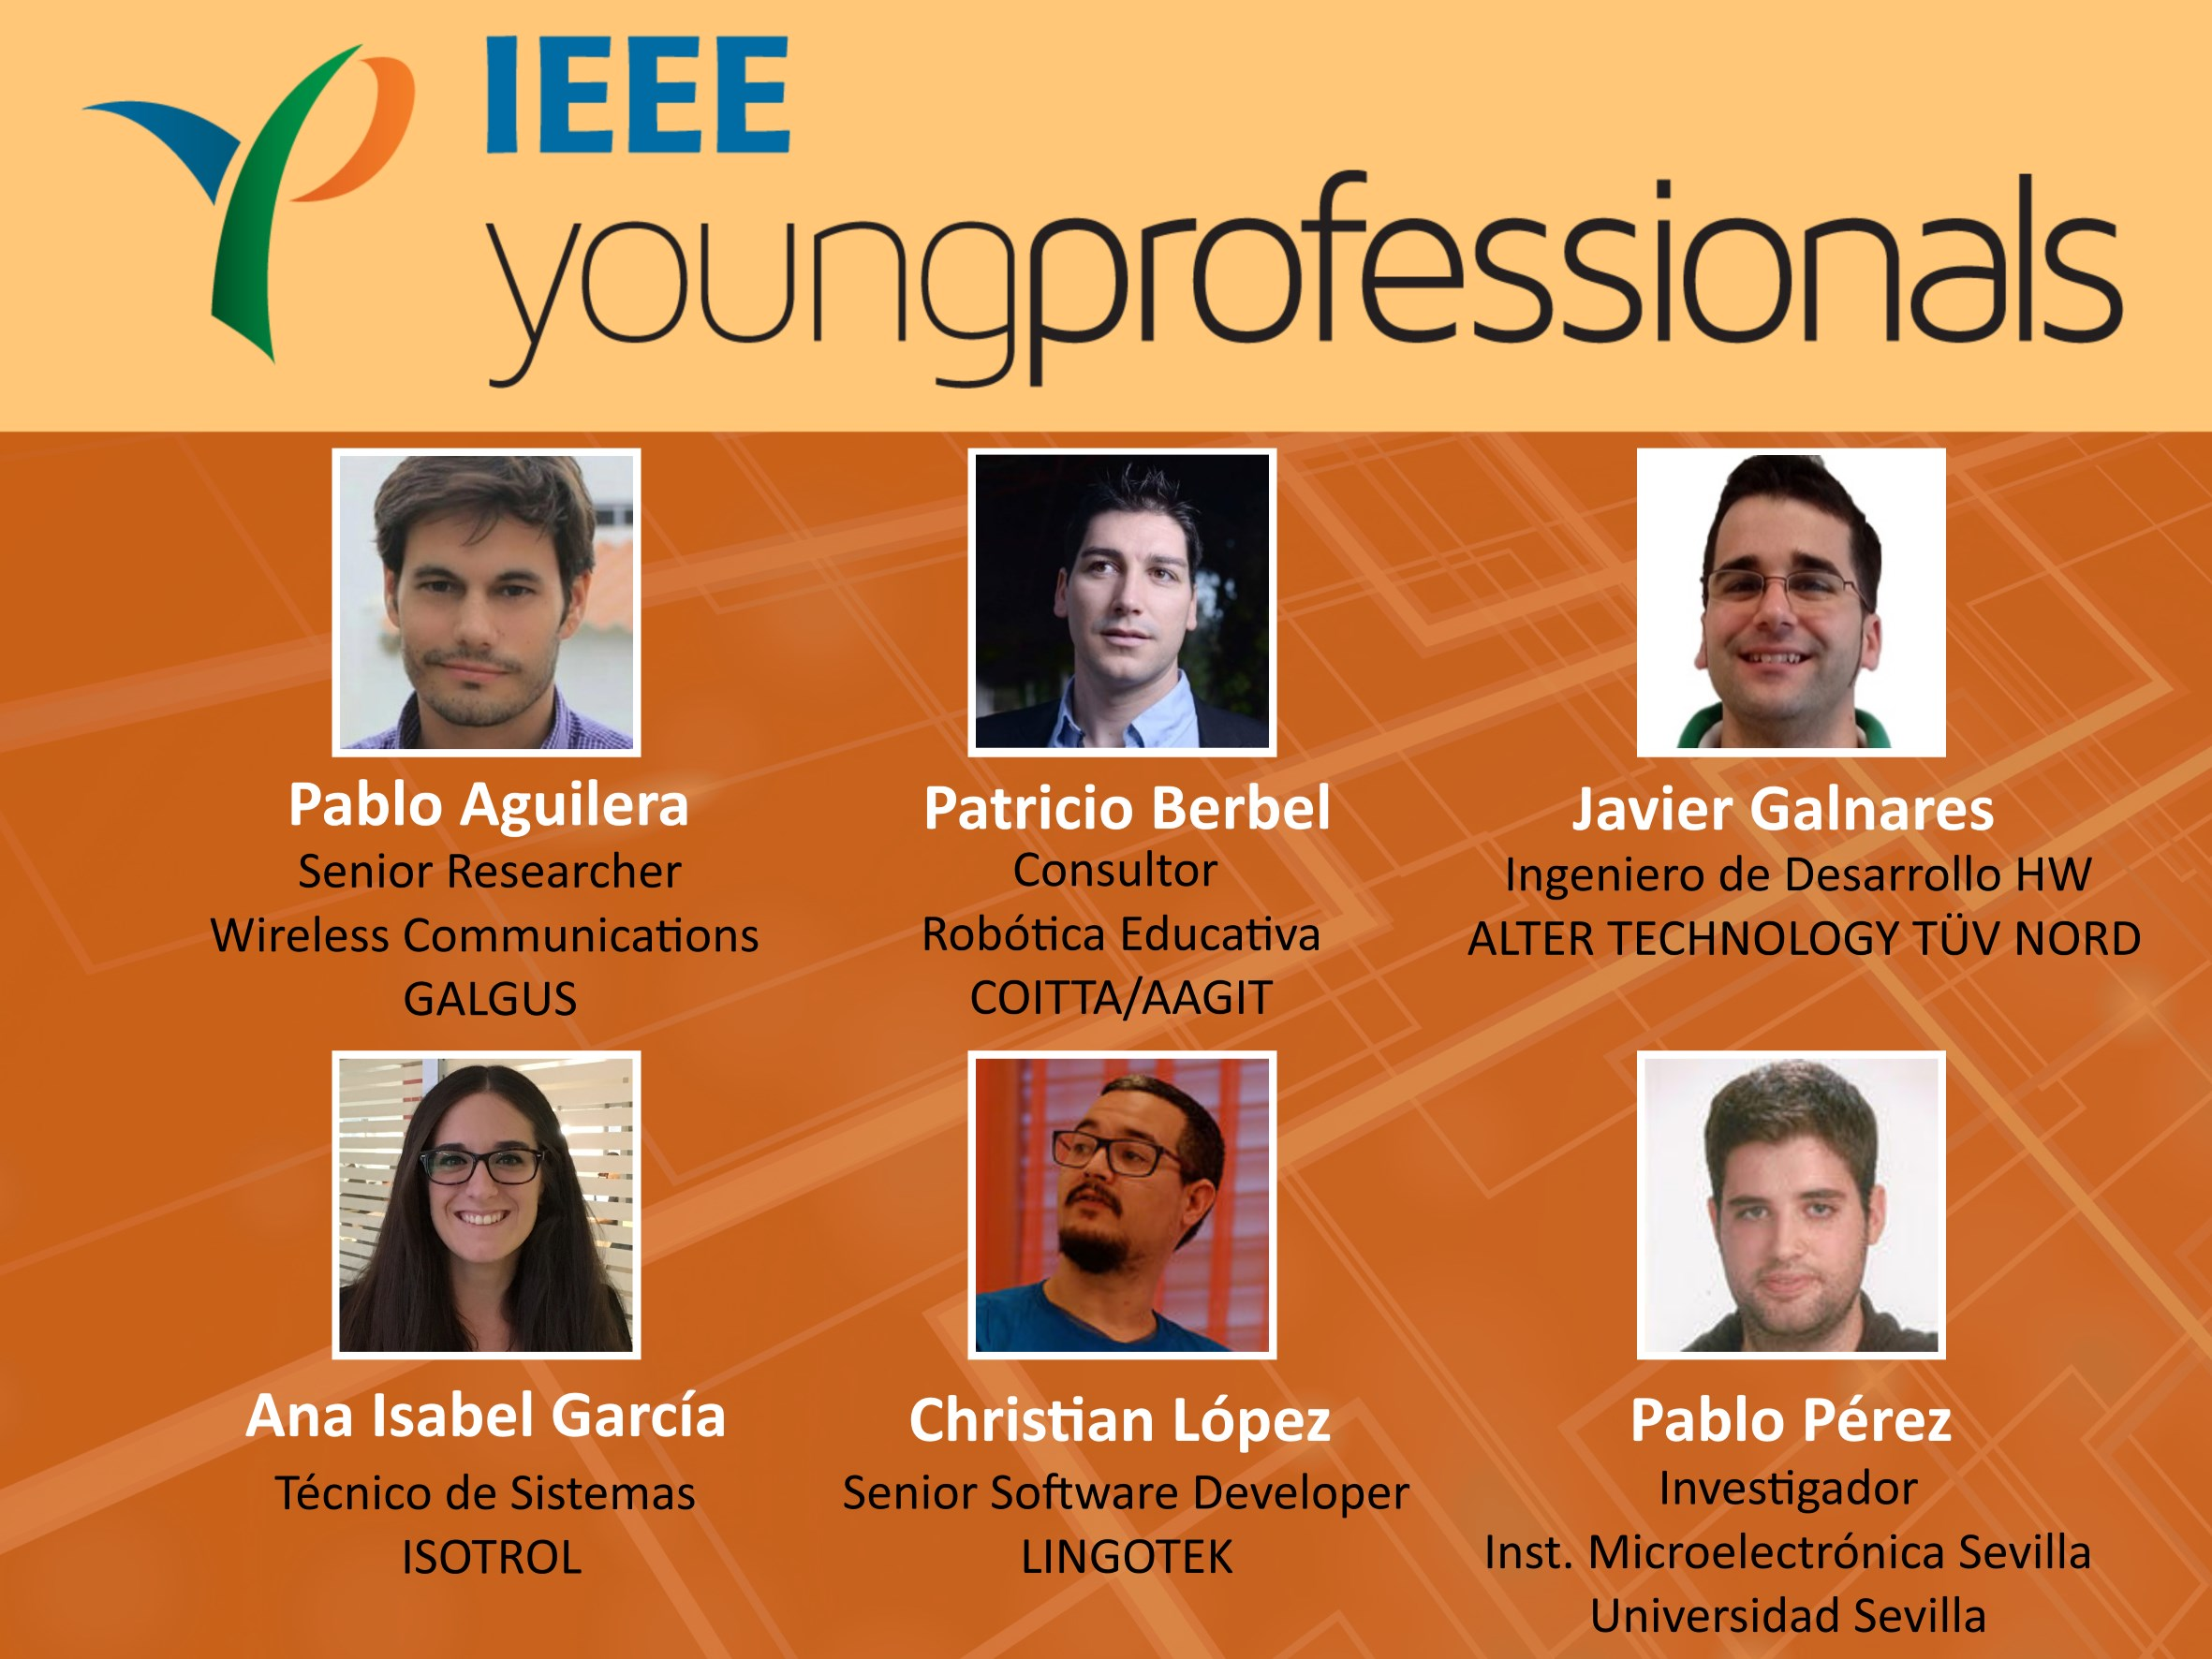

Slide 12


Slide 13


Slide 14


Slide 15


Slide 16
Summary!!!
Enjoy and contact with YP Team Spain
IEEE is the best
Graduate Student Member are Young Professionals
YP´Tour are comming to other cities
Provide us feedback with the survey!!!

Slide 17
Special Thanks - Sponsor

